Slide 1

Programming Language – I Lab

Slide 2

Example:
c=a+b
x<y
Expression can be true or false.
Zero ( 0 ) is false.
Anything but zero is true.

Slide 3
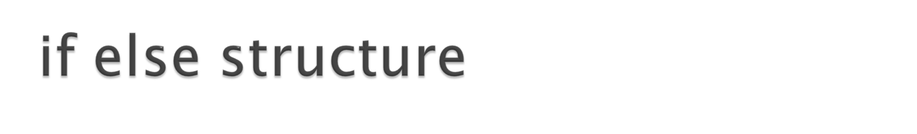
if(expression)
Statement;
else
Statement;

Slide 4
if(expression)
{
Statement;
Statement;
}
else
{
Statement;
Statement;
}

Slide 5
if(expression)
Statement;
Or
if(expression)
{
Statement;
Statement;
Statement;
}

Slide 6
if(expression)
Statement;
if(expression)
{
Statement;
Statement;
Statement;
}
if(expression)
Statement;

Slide 7
if(expression)
Statement;
else if(expression)
Statement;
else if(expression)
Statement;
else
Statement;

Slide 8
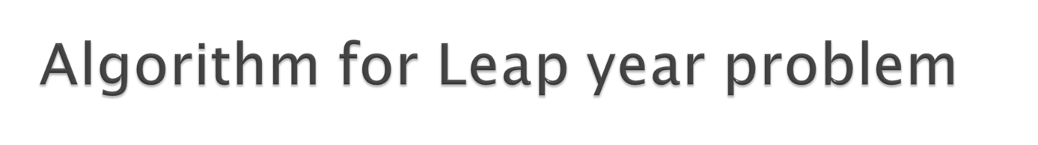
If year is divisible by 400
Then it is leap year
else if year is divisible by 100
Then it is not leap year
else if year is divisible by 4
Then it is leap year
else
It is not leap year

Slide 9
if(expression)
{
Statement;
Statement;
Statement;
}
else if(expression)
Statement;
else if(expression)
Statement;
else
Statement;

Slide 10

if(expression)
{
if(expression)
Statement;
else
Statement;
}
else
Statement;

Slide 11
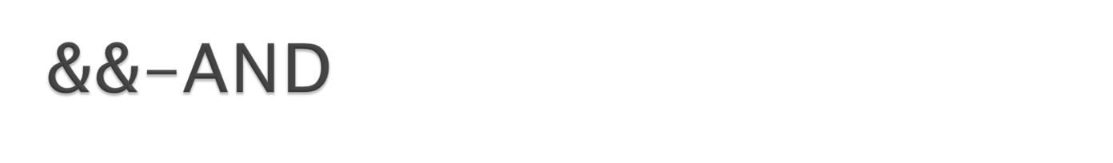
x>y && y<2
A | B | AND
True | True | True
True | False | False
False | True | False
False | False | False

Slide 12
x>y && y<2 && a<=k
The expression value is True if all the operands are true
and the expression value is false when any of them are false.

Slide 13

p<q || q<z
A | B | OR
True | True | True
True | False | True
False | True | True
False | False | False

Slide 14
x>y || y>2 || a<=k
The expression value is True if any of the operands are true
and the expression value is false when all of them are false.

